Slide 1
Interprocess communication comparison
Group members:
Affan Siddiqui
Taha Tasleem
Sharjeel khan

Slide 2
introduction
Inter-process Communication (IPC) is the mechanism provided by the Operating System, that allows process to communicate with each other.
This communication could involve a process letting another process know that some event has occurred or the transferring of data from one process to another.
There are various ways through which Inter-process communication can be implemented. Some of its mechanisms are Pipes, Shared Memory, Message Queues and etc.

Slide 3
Project Description
In this project we have implemented 3 problems using 2 methods of Interprocess Communication. The 3 problems are Fibonacci Series, Bubble Sorting and Matrix Multiplication. The 2 methods that we have used are Pipes and Shared Memory.

Slide 4
Pipes
pipe() is a system call that facilitates inter-process communication. It opens a pipe, which is an area of main memory that is treated as a "virtual file". The pipe can be used by the creating process, as well as all its child processes, for reading and writing.
One process can write and another related process can read from it.
If a process tries to read before something is written to the pipe, the process is suspended until something is written.
The pipe system call finds the first two available positions in the process's open file table and allocates them for the read and write ends of the pipe. Recall that the open system call allocates only one position in the open file table.

Slide 5
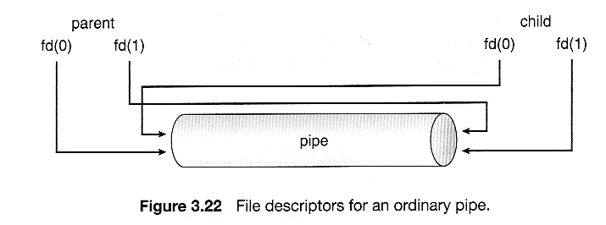

Slide 6
Shared memory
Inter Process Communication through shared memory is a concept where two or more process can access the common memory. And communication is done via this shared memory where changes made by one process can be viewed by another process.

Slide 7
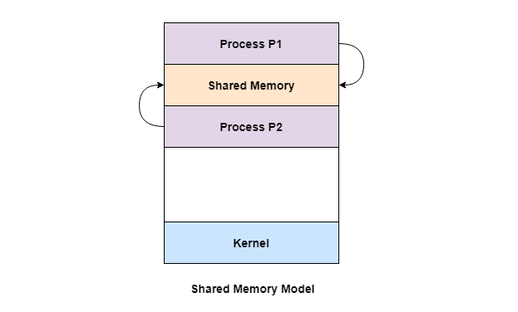

Slide 8
Shared memory system calls
Create the shared memory segment or use an already created shared memory segment (shmget())
Attach the process to the already created shared memory segment (shmat())
Detach the process from the already attached shared memory segment (shmdt())
Control operations on the shared memory segment (shmctl())

Slide 9
Fibonacci series comparison
USING PIPES:
Time for Parent Process: 0.000130
Time for Child Process: 0.000194
Total Time: 0.000328
USING SHARED MEMORY:
Time for Parent Process: 0.000119
Time for Child Process: 0.000138
Total Time: 0.000257

Slide 10
Sorting comparison
USING PIPES:
Time for Parent Process: 0.000731
Time for Child Process: 0.0001028
Total Time: 0.0008338
USING SHARED MEMORY:
Time for Parent Process: 0.00099
Time for Child Process: 0.000153
Total Time: 0.001143

Slide 11
Matrix multiplication
USING PIPES:
Time for Parent Process: 0.000282
Time for Child Process: 0.001035
Total Time: 0.001317
USING SHARED MEMORY:
Time for Parent Process: 0.000111
Time for Child Process: 0.000135
Total Time: 0.000246

Slide 12
Comparison result
The result shows that the any problem done with pipes was slower more than 5 times as compared with shared memory. So, we can say that shared memory is better and faster than pipes.

Slide 13
graph

Slide 14
Thank you!

